Slide 1
OPERATING SYSTEM
SESSION 1

Slide 2
What is operating system
an intermediary between the user of a computer and the computer hardware”
“manages the computer hardware”
“each [piece] should be … well delineated …, with carefully defined inputs, outputs, and functions”
“an amazing aspect of operating systems is how varied they are in accomplishing these tasks … mainframe operating systems … personal computer operating systems … operating systems for handheld computers …”
“in 1998, the United States Department of Justice filed suit against Microsoft, in essence claiming that Microsoft included too much functionality in its operating system … for example, a web browser was an integral part of the operating system

Slide 3
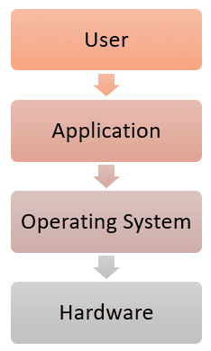
An operating system (OS) is:
a software layer to abstract away and manage details of hardware resources
a set of utilities to simplify application development
“all the code you didn’t write” in order to implement your application

Slide 4
The OS and hardware
An OS mediates programs’ access to hardware resources
Computation (CPU)
Volatile storage (memory) and persistent storage (disk, etc.)
Network communications (TCP/IP stacks, Ethernet cards, etc.)
Input/output devices (keyboard, display, sound card, etc.)
The OS abstracts hardware into logical resources and well-defined interfaces to those resources
processes (CPU, memory)
files (disk)
sockets (network)

Slide 5
Why bother with an OS
Application benefits
programming simplicity
See high-level abstractions (files) instead of low-level hardware details (device registers)
Abstractions are reusable across many programs
portability (across machine configurations or architectures)
Device independence: 3Com card or Intel card?
User benefits
Safety
Program “sees” own virtual machine, thinks it owns computer • OS protects programs from each other. OS fairly multiplexes resources across programs
efficiency(cost and speed)
Share one computer across many users
Concurrent execution of multiple programs

Slide 6
INSIDE OS
Process and it's management
Threads and concurrency
Scheduling
Memory management
Inter process communication
I/O management

Slide 7
TYPES OF OS
Distributed OS
Parallel OS
Client/Server Computing
Embedded/Mobile Computing

Slide 8
Activity TIME

